Slide 1
Digital Fraud for MVP
What we know
16th Feb 2021

Slide 2
C1’s Roles in CWB
Multi-layered responsibilities for Cybersecurity and Fraud Operations
Member Direct for the internet banking
  User authentication
  RSA risk scoring
  Integration with T24 and other CWB systems
Payment Gateway (Direct Clearer for Interac and Bill Payments)
  Transaction processing
  Reconciliation of payments and transfers
  Dispute resolutions and reversals
FAS for Fraud management
  Fraud alert and case management

Slide 3
C1 Member Direct
Role in Cybersecurity and Fraud Operations
C1 Member Direct do have a number of other features for fraud identification
  PAC Blocker – locks an account after 3 invalid login attempts
  Umpire – blocks a PAC if it is being used for brute for attacks
  Extended PAC – allows for alphanumeric passwords up to 30 characters long
  Mobile Alerts – used to SMS/Email alerts to clients on different triggers
  RSA Increased Authentication – Supports risk scoring user activities such as login, payments and transfers. C1 do not monitor the cases/scores it generates
Provide summary and detailed reports about the number and types of transactions processed
ACTION:
We have to find solutions for these within Infinity (not Navaera) as they are tightly coupled with online banking
Notes:
Okta will fulfill most of these requirements for us in Infinity.

Slide 4
C1 Direct Clearer/Payment Gateway
Role in Fraud Operations
During the investigation of issues
  We rely on their services to connect us with other FIs
  To help recover funds from other FIs
Provide summary and detailed reports about the number and types of transactions processed
ACTION:
We will continue to use this system as it is so no change required here or in our business processes.

Slide 5
C1 FAS
Role in Fraud Operations
Do not do any fraud analysis of its own
C1 FAS generates alerts for us
Provides information about the alert and workflow functionality to keep track of all the cases
ACTION:
These are the responsibilities that have to be fulfilled by Navaera either Like-for-Like or better.

Slide 6
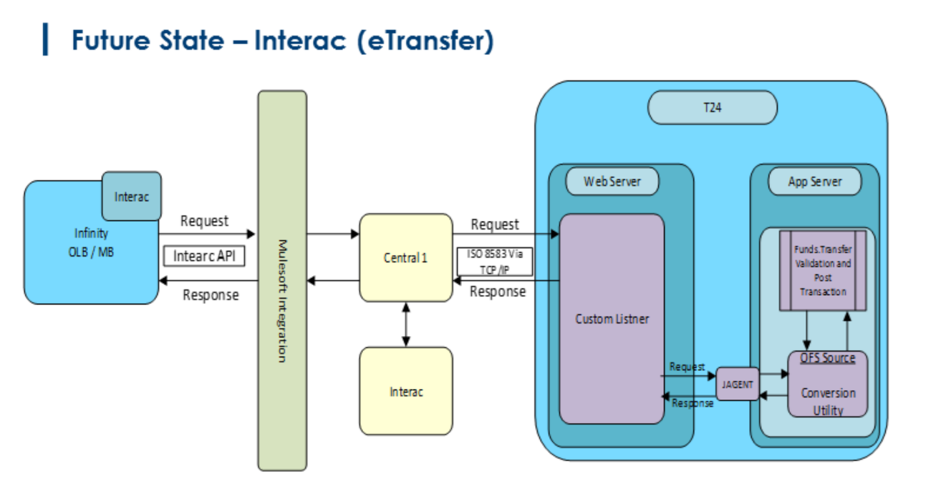
Future State for CWB
Cybersecurity and Fraud Operations
Replace C1 Member Direct’s Cybersecurity capabilities with Like-for-Like or better capabilities in Infinity
C1 will continue to be CWB’s Direct Clearer for Interac and Bill Payment transactions
We may decide to replace FAS with Navaera Like-for-Like or better

Slide 7
Fraud Coverage Today
Like-for-Like Replacement or No Replacement of FAS
S.No. | Transaction/Service | CURRENT | Additional Details | FUTURE | Additional Details
1 | Interac e-transfers outgoing | Yes | Done in real time by Interac | Yes | We should do our own risk scoring as well – as we rely only on interac today
2 | Interac e-transfers incoming | Yes | Done in real time by Interac | Yes | We should do our own risk scoring as well – as we rely only on interac today
3.a | Bill payments – Case management | Yes | Cases are identified manually through EDW reports and FAS is only being used to log them | Yes | Same functionality will be provisioned
3.b | Bill payments – fraud analysis | No |  | No | Will continue to do manual analysis and use the new system for case/alert management – out of scope for fraud analysis by Navaera

Slide 8
Business Process Today
Outgoing e-Transfers
Interac analyzes the fraud for us
Interac may or may not block transactions in real time
C1 FAS generates alerts for us
FSIS perform their own investigation(all manual)
FSIS uses C1’s clearing operations for connecting with other FIs for investigation

Slide 9
Business Process Today
Incoming e-Transfers
Interac analyzes the fraud for us
Interac may or may not block transactions in real time
C1 FAS generates alerts for us
FSIS perform their own investigation(all manual)
FSIS uses C1’s clearing operations for connecting with other FIs for investigation

Slide 10
Business Process Today
Bill Payments
No role of C1’s FAS in this
RSA risk score do get generated for these transactions but is not being used by FSIS team today to investigate

Slide 11
Special Mention
RSA Increased Authentication
An SDK tightly coupled with C1 Member Direct that does the following:
  Assign scores to user activities on online banking. Activities include login, e-transfers and bill payments
  Provides step-up authentication for high risk login operations only
  Assign scores to bill payments and e-transfers but never blocks transactions or pass additional data to other systems down the line
  Based on policies defined at the bank, the SDK generates alerts. In CWB those alerts are getting generated (but not used) for bill payments

Slide 12
Special Mention
Additional Visibility for Fraud Analysis/Scoring
C1 Member direct does capture device information and share it with RSA SDK for its analysis
None of this information is passed onto FAS or Interac for aiding the fraud analysis/scoring it does
Interac do utilize data from Threatmatrix but it fetches that on its own

Slide 13
References
Detailed current state of business process
Current state of business process for Digital MVP(Outgoing e-Transfer, Incoming e-Transfer, Bill payments)
Business requirements for Digital MVP
Screenshots of the systems being used by CWB FSIS today
C1’s Cybersecurity services product sheet

Slide 14
Thank You

